Slide 1

Water level indicator
GROUP - 06
NAME | ID
MD. SHOHANUR RAMAN SHOHAN | 22-46013-1
RUDRO SHINE DATTA | 22-46723-1
A. H. M. TANVIR | 22-47034-1
ABIR BOKHTIAR | 22-47038-1
A. F. M .RAFIUL HASSAN | 22-47048-1
Digital Logic & Circuits Lab
Section - L
Fall 2023-24
Department of EEE
American International University-Bangladesh
WITH INSIGHT FROM RESPECTED
NUZAT NUARY ALALM

Slide 2

Introduction
Motivation
Objectives
Methodology
Hardware and Simulation
Result and Discussion
Project Cost
Limitation & Conclusion
References
TOPICS

Slide 3
INTRODUCTION
The water level indicator is an essential device for monitoring the water level in various water reservoirs. It helps to prevent overflow, save water, and protect the water pump from dry running. In this presentation, we present a water level indicator electronics project that uses a simple circuit to indicate the water level in a tank.

Slide 4
MOTIVATION
The need for a water level indicator arises from the fact that water is a precious resource, and wastage of water due to overflowing or dry running of the pump is not only harmful to the environment but also causes a financial loss. Therefore, a water level indicator is a cost-effective and practical solution to this problem.

Slide 5
Objectives
The primary objective of this project is to design and implement a water level indicator using 555 timer. Specific objectives include:
1. To learn the working of a water indicator.
2. Measure the water level when the circuits indicate when the tank is half and full.
3. To learn how to build simple circuits.
4. To check the level of water in the tank. Depending on the water level, the motor switches ON when the water level goes below a predetermined level or the motor switches OFF when the tank is full.

Slide 6
METHODOLOGY
In this project we have designed a system which has the ability to detect the level of water in a tank and switches ON or OFF the pump accordingly and displays the status on the LCD screen. The system also monitors the level of water in the sump tank (source tank). If the level inside the sump tank is low, the pump will not be switched ON and this protects the motor from dry running. A beep sound is generated when the level in the sump tank is low or if there is any fault with the sensors. We have used equipments such as -
1. 12-volt power supply 8. LED
2. Buzzer
3. Resistor
4. 555 timer IC
5. Capacitor
6. Connecting Wires.
7. Breadboard.

Slide 7
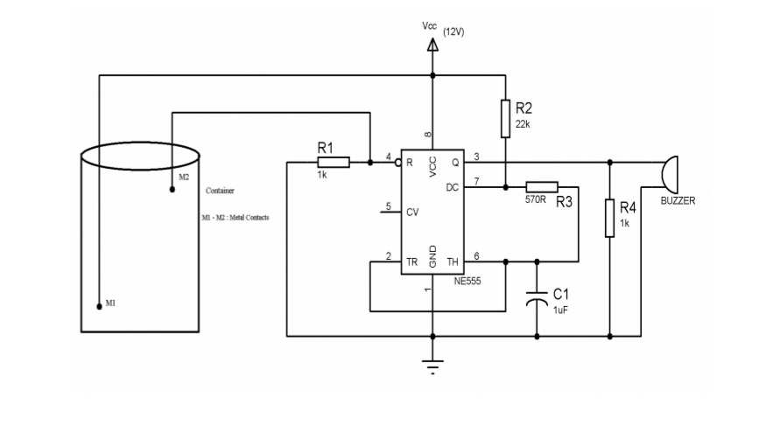
CIRCUIT DIAGRAM

Slide 8
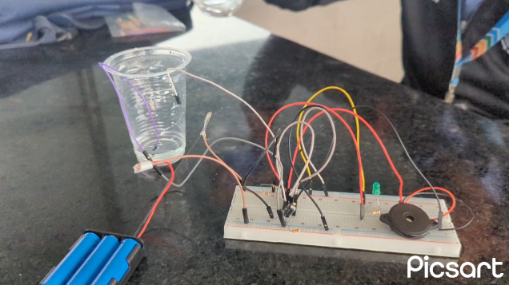
Practical implementation of CIRCUIT

Slide 9
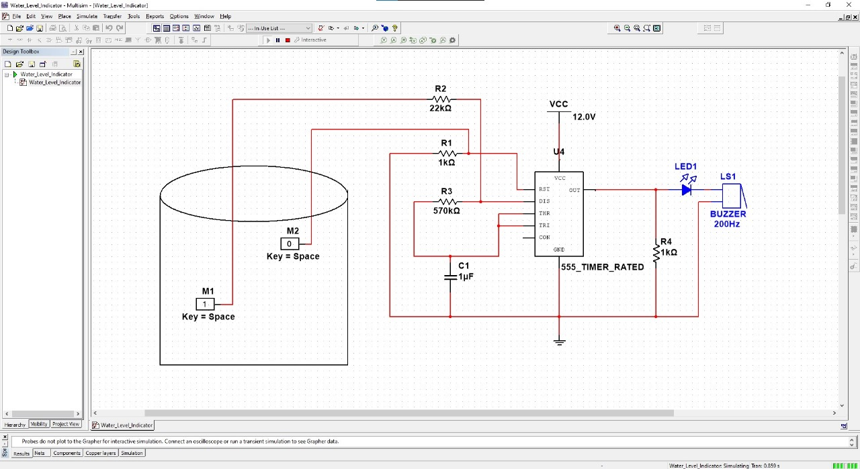
Simulation

Slide 10
RESULT & DISCUSSION
The water level indicator circuit was successfully implemented using necessary component which we discuss in methodology part. The circuit was tested with a demo water tank, and the results were satisfactory. The LED indicators lit up and buzzer turn on according to the water level in the tank, indicating a full level.

Slide 11
PROJECT COST
# | Items | Quantity | Amount
1 | Breadboard | 1 | 150
2 | 3.7V rechargeable Battery | 3 | 315
3 | Battery holder | 1 | 50
4 | 570 Ω Resistor | 5 | 7.5
5 | 1 KΩ Resistor | 5 | 7.5
6 | 22 KΩ Resistor | 5 | 7.5
7 | LED (5mm) | 4 | 8
8 | Buzzer (3-9V) | 1 | 50
9 | Jumper cable | 10 | 30
10 | NE-555 timer | 4 | 140
11 | Capacitor | 2 | 14
12 | Miscellaneous | - | 100
12 | Grand Total | - | 879.5 BDT

Slide 12
LIMITATION
The water level indicator circuit presented in this project has some limitations. It is not suitable for very large water tanks or reservoirs due to the limited number of LED indicators. Additionally, the circuit is not waterproof, and care must be taken to prevent it from getting wet.

Slide 13
CONCLUSION
In conclusion, the water level indicator electronics project presented in this project is a simple and effective solution for monitoring the water level in a tank. It is easy to construct, cost-effective, and can be built by novice hobbyists with basic electronics knowledge. This project can help save water, prevent overflow, and protect the water pump from dry running.

Slide 14
REFERENCES
[1] Tarun Naruka,Abhishek Singh,Anmol Janu, Anurag Gocher,Arpit Sharma, “Automatic Regulation ofWater Level throughAutomatic Relay Switching Operation”
[2] Madhurima Santra, Sanjoy Biswas, Sibasis Bandhapadhyay and Kaushik Palit, Smart Wireless water level Monitoring & Pump controlling System, International Journal of Advances in Scientific Research and Engineering (IJASRE),Vol. 03, Issue 4, May 2017.
[3] Md.SouroveAkther Momin, Pratik Roy, Samiul Islam, “International Journal of Research Construction of Digital Water Level Indicator and Automatic Pump Controlling System”
[2] Water level (device), https://en.wikipedia.org/wiki/Water_level_(device)
[3] Robodoc, https://robodocbd.com/

Slide 15
THANK YOU

